Slide 1
Pathogens + Hygiene Indicators
In one single PCR reaction
Fecal Contamination Indicator
GMP Indicator
Salmonella
Listeria monocytogenes

Slide 2

100+ acidophilic bacteria
100+ yeast & molds
Preservative resistant yeasts
Brettanomyces species

Slide 3

Salmonella
E. coli O157:H7
E. coli STEC

Slide 4

Results in ~8 hours
Salmonella

Slide 5
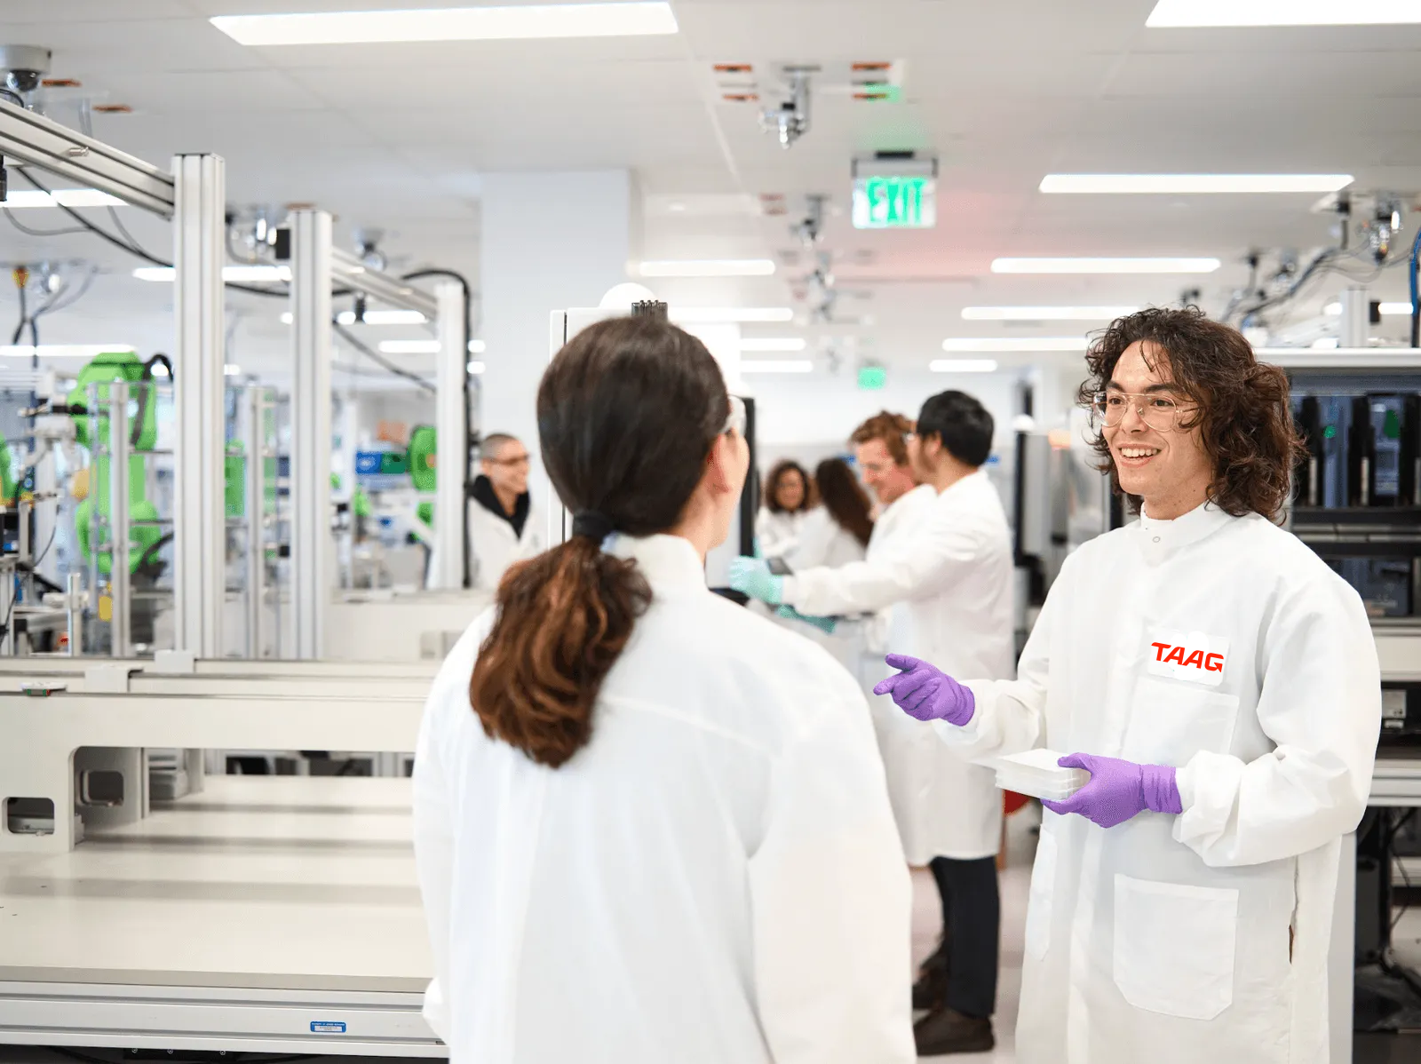
Indicators
E. coli
S. aureus
E. coli O157:H7
Spoilage
TxA
Listeria spp
Enterobacteria
L. monocytogenes
PRY
AiGOR
LABs
Molds
E. coli STEC
Yeasts
Salmonella

Slide 6
Indicators
S. aureus
E. coli
E. coli O157:H7
Spoilage
Listeria spp
L. monocytogenes
TxA
Enterobacteria
PRY
Molds
Salmonella
Yeasts
AiGOR
LABs
E. coli STEC

